Slide 1
Introduction to analytic tools for big data
2017.02.21 簡廷因

Slide 2
Outline
Introduction to R & Install
Basic R programming

Slide 3
Reference
Website:
http://cran.r-project.org/doc/manuals/R-intro.html
http://www.statmethods.net/
http://manuals.bioinformatics.ucr.edu/home/R_BioCondManual
Book
http://www.manning.com/kabacoff2/

Slide 4
Introduction to R

Slide 5
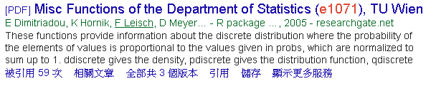
What is R?
R is a programming language and software environment for statistical computing and graphics
more than 10,000 additional packages (Jan 2017) available
You can make your own contribution in the future.

Slide 6
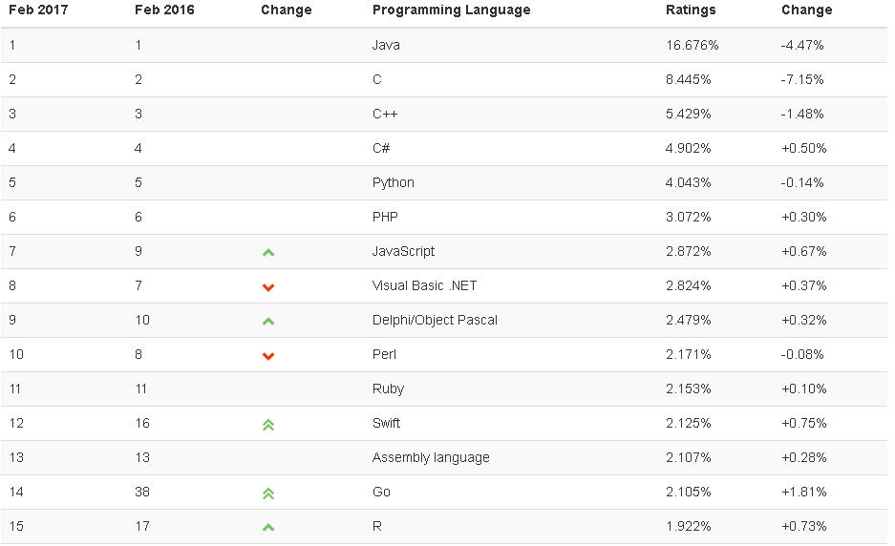
Introduction to R
Ref: http://www.tiobe.com/tiobe-index/

Slide 7

Introduction to R
Advantages :
Free
Cross platform
Integrate Hadoop
Modify code easily
Generate graphics easily and quickly
Disadvantages:
No friendly UI
Need to know packages and function name
SAS VA :
~150K / core

Slide 8
Install R & Rstudio

Slide 9
Install R & Rstudio
Step1: download R
https://ftp.yzu.edu.tw/CRAN/bin/windows/base/R-3.3.2-win.exe
Version: 3.3.2
Step2:Install
Always "NEXT"
Step3: Finish

Slide 10
Introduction to RStudio

Slide 11
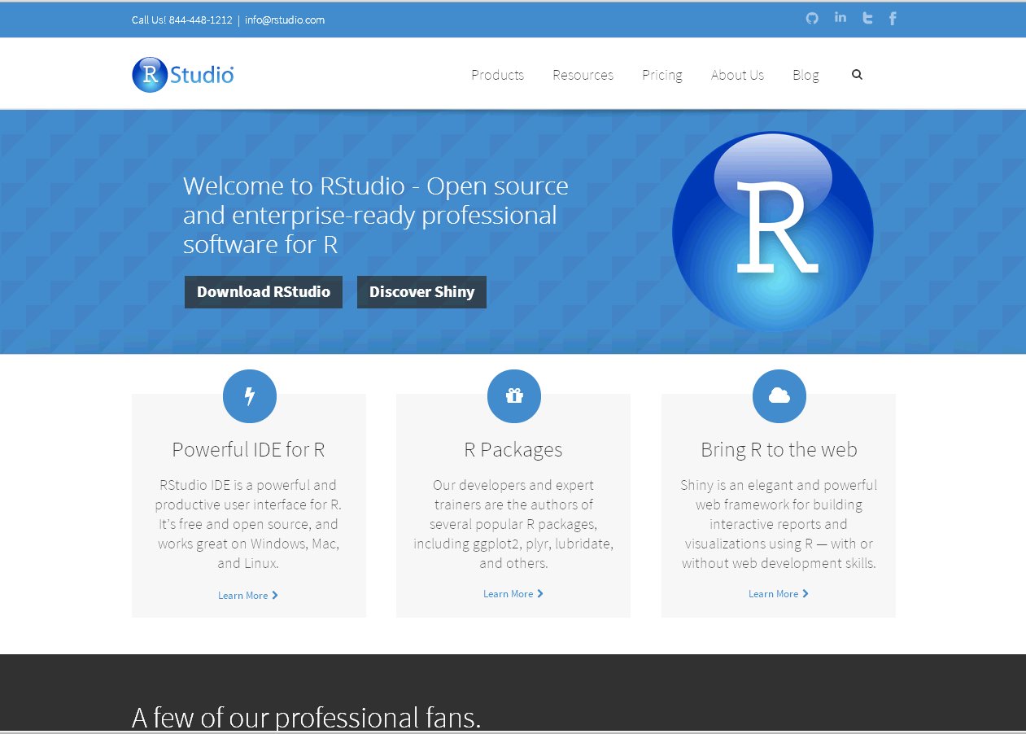
R studio (http://www.rstudio.com/)

Slide 12
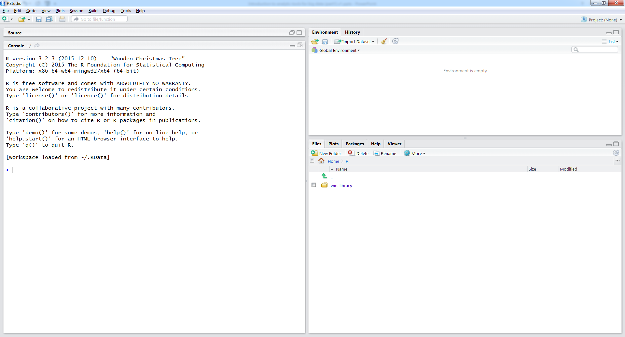
Installation
RStudio requires R 2.11.1 (or higher).
http://cran.rstudio.com/
RStudio download page
http://www.rstudio.com/products/rstudio/download/

Slide 13
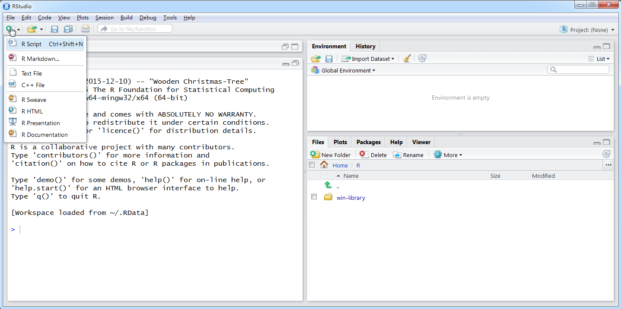
Get ready to RStudio

Slide 14
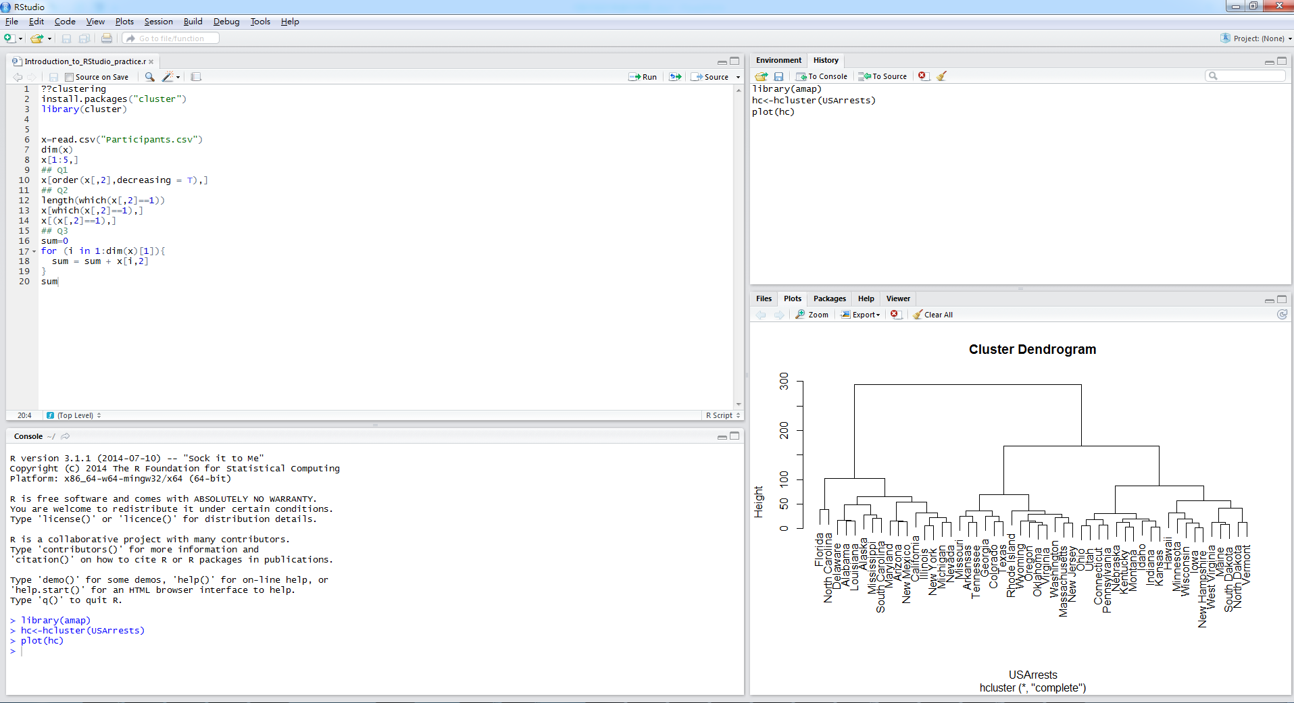
Get ready to RStudio
Ctrl + 1
Ctrl + 2

Slide 15
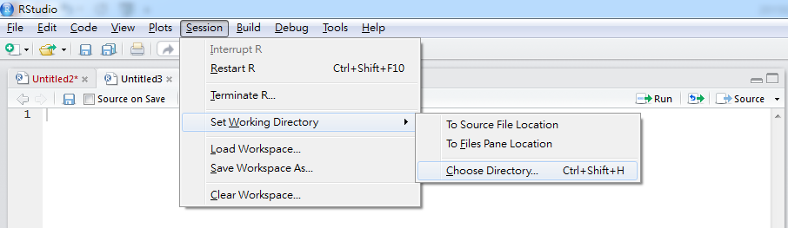
Get ready to RStudio
Set Working Directory
setwd("D:\")

Slide 16
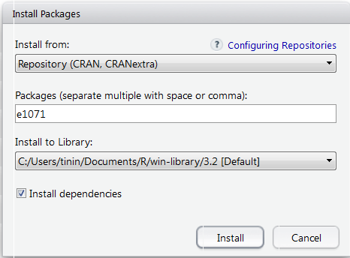
Get ready to RStudio
Install Packages
install.packages("PACKAGENAME")

Slide 17
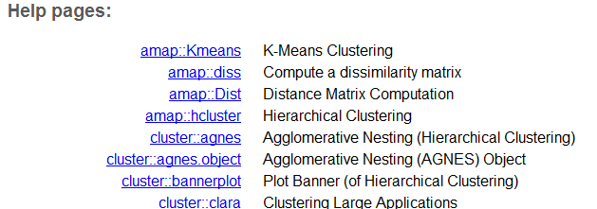
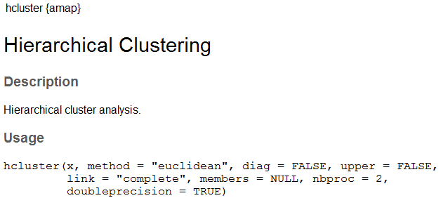
Suggestion step to install packages
Step 1: ??hcluster
Step 2: install.packages("amap")
Step 3: library(amap)
Step 4: ?hcluster/ args(hcluster) / example(hcluster)

Slide 18
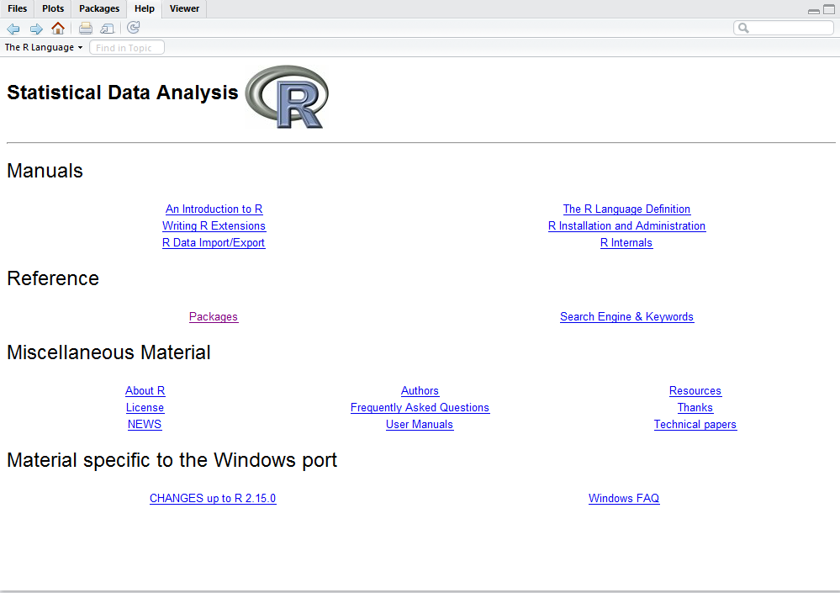
Get ready to RStudio
?plot, help("plot") #知道指令名稱help.search("plot") #不知道指令名稱apropos("plot") #函數名稱中有"plot"字串的所有函數
find("plot") # plot在哪個package
getAnywhere("plot") #plot函數出現在哪些package
args("plot") # 查詢plot參數
Manuals

Slide 19
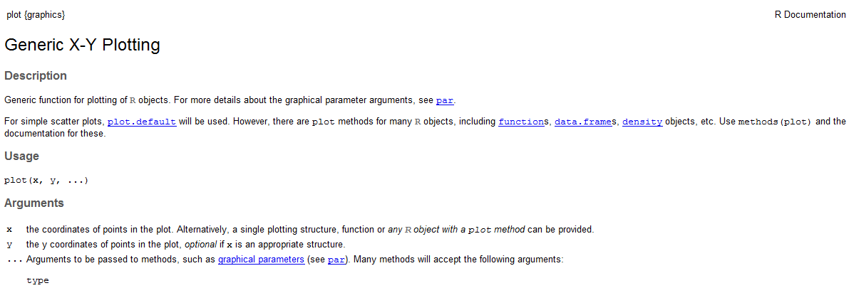
Get ready to RStudio
Manuals

Slide 20
Get ready to RStudio
Description: 摘要說明
Usage: 使用語法
Arguments:參數說明
Details: 完整說明
Value: 輸出項目
References: 參考文件
See Also: 其它相關函式 其它相關函式
Examples: 舉例
args("plot")
example("plot")

Slide 21
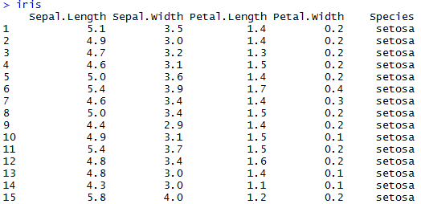
Get ready to RStudio
Arguments
args(agnes)
Necessary arguments, optimal arguments
Arguments order
Arbitrary order, Must be given arguments’ name
agnes(iris, metric="euclidean",method="single")
By order, do not need arguments’ name
Note : install package "cluster"

Slide 22
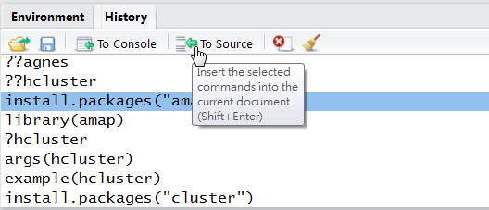
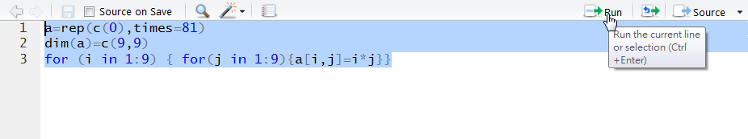
Get ready to RStudio
You may key-in commands directly in R environment or on a R script instead
history() to recall the previous commands
Ctrl+R to run the script

Slide 23
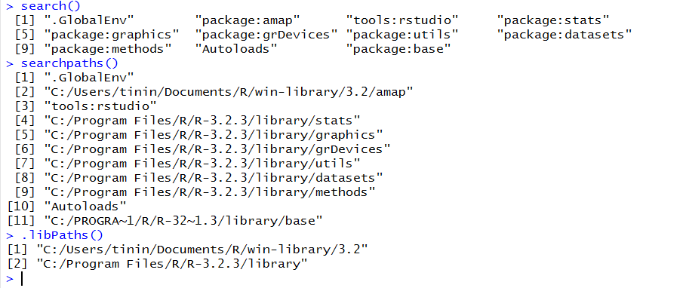
Get ready to RStudio
System information
search() , searchpaths()
Gives a list of attached packages
.libPaths()
gets/sets the library trees within which packages are looked for

Slide 24
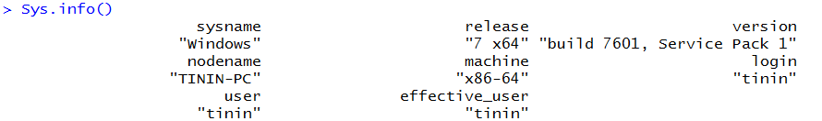
Get ready to RStudio
System information
Sys.info()

Slide 25
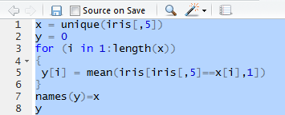
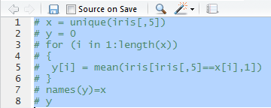
Get ready to RStudio
Comment line
#
Comment lines
Step 1: select
Step 2 : ctrl + shift + c

Slide 26
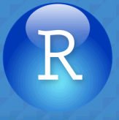
Exercise
Download & install RStudio
Open RStudio
Open new project
Open R script：example.r
Please check working directory
Execute the script

Slide 27
Basic R Programming

Slide 28
Basic R Programming
R includes objects and function：
object：
3.0
"YZU"
c(2.5, 3.4, 7.1, 0.5)
function：
sqrt(3/4)
exp(3.72)

Slide 29
Basic R Programming- assignment
Variable <- object
a<-2
Variable = object
a=2
object -> Variable
2->a

Slide 30
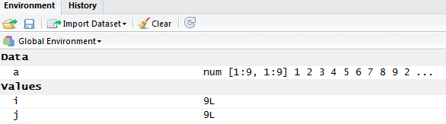
Basic R Programming- Naming
Include A-Z, a-z, 0-9, ".", "_"
Case sensitive
_ can’t located at 1st position
. at 1st position (hidden variable)
List all object
ls(all.names=T)

Slide 31
Basic R Programming- Object
Numeric, Character
a=2
b="abc"
Vector, matrix
x = c(1,2,3)
y = matrix(c(1,2,3,4,5,6),nrow=3,ncol=2)
R function result
function
sum_fn<-function(x,y) { a= x+y}

Slide 32
Some example
> 2+3
[1] 5
> sqrt(3/4)/(1/3-2/pi^2)
[1] 6.626513
> exp(3.72)
[1] 41.26439
> sin(pi)
[1] 1.224606e-16
> log(10)
[1] 2.302585
> log2(10)
[1] 3.321928
> log10(10)
[1] 1

Slide 33
Basic R Programming- operator
> A = array(1:6, c(3, 2))
> A
[,1] [,2]
[1,] 1 4
[2,] 2 5
[3,] 3 6
> B = array(7:8, c(2, 1))
> B
[,1]
[1,] 7
[2,] 8
> A %*% B
[,1]
[1,] 39
[2,] 54
[3,] 69
Basic operator
+, -, *, /
^ (power)
%%(remainder)
%/% (quotient)
%*%(matrix multiplication,
inner product)
t(transpose)
%o%(outer product)
> 2^3
[1] 8
> 35 %% 4
[1] 3
> 35 %/% 4
[1] 8

Slide 34
Basic R Programming- operator
Logical operator
|, ||, &, &&
TRUE(T), FALSE(F)
<, =, >, <=, >=, !=, ==
> x=c(1,2)
> (x==1)|(x==3)
[1] TRUE FALSE
> (x==1)||(x==3)
[1] TRUE
> a=2
> b=3
> c=a=b
> c
[1] 3
> a=2
> b=3
> c=a==b
> c
[1] FALSE

Slide 35
Basic R Programming- keywords
keywords
# (Comment)
NA, NaN, is.na, is.nan
pi (π)
exp (nature number)

Slide 36
Basic R Programming- Basic statistics function
Basic statistics function
log (ln)
log2
log10
abs(absolute value)
ceiling
floor

Slide 37
Basic R Programming- Basic statistics function
Basic statistics function
min
max
mean
median
sum
var(variance)
sd(standard deviation)
quantile
summary
> x=c(1,3,5,7,9)
> max(x)
[1] 9
> min(x)
[1] 1
> mean(x)
[1] 5
> median(x)
[1] 5
> sum(x)
[1] 25
> var(x)
[1] 10
> sd(x)
[1] 3.162278
> quantile(x)
0% 25% 50% 75% 100%
1 3 5 7 9
> summary(x)
Min. 1st Qu. Median Mean 3rd Qu. Max.
1 3 5 5 7 9

Slide 38
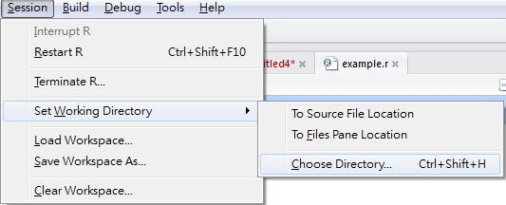
Exercise
Please calculate min, max, mean, median, variance and standard deviation score in "score_exercise.csv"
Hint :
Please check working directory
x=read.csv("score_exercise.csv",sep=",",header=T)
score=x[,2]

Slide 39
Basic R Programming- data type
Numeric
Integer
-2*109 ~ 2*109
x=3
Real number
X=3.14
Character
x="3"
Complex number
x=1+2i

Slide 40
Basic R Programming- data type
Logical
x=TRUE
x=T
factor(x, ordered=F)
x=factor( c("a", "b", "c"), ordered=T)
Date
as.Date(x, format="%Y-%m-%d")
x=as.Date("2016-02-23")
> x=as.Date("2016-02-23")
> months(x)
[1] "二月"
> weekdays(x)
[1] "星期二"

Slide 41
Basic R Programming- data type
Missing data
NA (is.na)
NaN(is.nan, is.na)
Vectors
Matrices
Lists
Data frames

Slide 42
Basic R Programming- data type
Data type transfer
is.* 是否為…
as.* (強迫)使為…
> x="abc"
> is.character(x)
[1] TRUE
> is.integer(x)
[1] FALSE
> a=as.numeric(x)
Warning message:
NAs introduced by coercion
> a
[1] NA
> x="abc"
> mode(x)
[1] "character"
> x=1
> mode(x)
[1] "numeric"

Slide 43
Basic R Programming- data type
Data type transfer
Date <-> Character
> x = as.Date("2016/02/23")
> a = as.character(x)
> a
[1] "2016-02-23"
> as.numeric(substring(a,1,4))#year
[1] 2016
> as.numeric(substring(a,6,7))#month
[1] 2
> as.numeric(substring(a,9,10))#day
[1] 23

Slide 44
Basic R Programming- data type
Date operator
> x = as.Date("2016/02/23")
> x = x+1 # add 1 day
> x
[1] "2016-02-24"
> y = as.Date("2017/02/23")
> a = difftime(y,x,unit="days")
> a
Time difference of 365 days
> as.integer(a)
[1] 365
> age = as.integer(difftime(Sys.Date(),"2001-01-01",unit="days") /365.25)
> age
[1] 15

Slide 45
Basic R Programming- vector(向量)
vector: must have the same mode(numeric, character, etc.)
> x=c(1,1,1,2,2,3)
> x
[1] 1 1 1 2 2 3
> names(x)=c("A","B","C","D","E","F")
> x
A B C D E F
1 1 1 2 2 3
> x[4]
D
2
> x=unname(x)
> x
[1] 1 1 1 2 2 3
> x[2:4]
[1] 1 1 2

Slide 46
Basic R Programming- vector(向量)
operator
> x=c(1,2,3,4)
> y=c(5,6,7,8)
> x*y
[1] 5 12 21 32
> y=c(5,6)
> x*y
[1] 5 12 15 24
> y=c(5,6,7)
> x*y
[1] 5 12 21 20
Warning message:
In x * y : longer object length is not a multiple of shorter object length
> y=2*x+1
> y
[1] 3 5 7 9

Slide 47
Basic R Programming- vector(向量)
> x=c(3,1,2,1,1,4)
> names(x)=c("A","B","C","D","E","F")
> x[x==1]
B D E
1 1 1
> which(x==1)
B D E
2 4 5
> unique(x)
[1] 3 1 2 4
> length(x)
[1] 6
> sort(x)
B D E C A F
1 1 1 2 3 4
> order(x)
[1] 2 4 5 3 1 6
> order(x, decreasing=T)
[1] 6 4 5 1 2 3

Slide 48
Exercise
Please calculate the final score of each student in "finalscore_exercise.csv"
Final score = 0.3 * HW + 0.3 * Midterm + 0.4 * final exam
Hint :
Please check working directory
x=read.csv("finalscore_exercise.csv",sep=",",header=T)

Slide 49
Basic R Programming- vector(向量)
Generate sequences
seq()
rep()
> x=1:5
> x
[1] 1 2 3 4 5
> x=seq(0,10,by=2)
> x
[1] 0 2 4 6 8 10
> x=seq(length=6,from=0,by=1)
> x
[1] 0 1 2 3 4 5
> x=1:3
> y=rep(x,times=2)
> y
[1] 1 2 3 1 2 3
> y=rep(x,each=2)
> y
[1] 1 1 2 2 3 3

Slide 50
Basic R Programming- vector(向量)
character
x=c("a","b","c")
escape sequences
\n : newline
\t : tab
\b : backspace
\" : quotation mark
\\ : backslash

Slide 51
Basic R Programming- vector(向量)
Vector concatenate
> x=c(1,2,3,4)
> y=paste("a",x,sep=":")
> y
[1] "a:1" "a:2" "a:3" "a:4"
> y=paste("a",x,sep="")
> y
[1] "a1" "a2" "a3" "a4"
> x=c(x,5:7)
> x
[1] 1 2 3 4 5 6 7
> x=c(x,c(8,9))
> x
[1] 1 2 3 4 5 6 7 8 9

Slide 52
Basic R Programming- vector(向量)
NA to zero
> x=c("1","2","3","A","B","C")
> mode(x)
[1] "character"
> y = as.integer(x)
> y
[1] 1 2 3 NA NA NA
> mode(y)
[1] "numeric"
> y[is.na(y)] = 0
> y
[1] 1 2 3 0 0 0

Slide 53
Basic R Programming- Basic statistics function
Basic statistics function
na.rm = T
> x=c("1","2","3","A","B","C")
> mode(x)
[1] "character"
> y = as.integer(x)
> y
[1] 1 2 3 NA NA NA
> mean(y)
[1] NA
> mean(y,na.rm=T)
[1] 2

Slide 54
Basic R Programming - matrix(矩陣)
matrix, array : must have the same mode(numeric, character, etc.)
> x = matrix(1:6,nrow=2,ncol=3)
> x
[,1] [,2] [,3]
[1,] 1 3 5
[2,] 2 4 6
> y = matrix(1:6,nrow=2,ncol=3,byrow=T)
> y
[,1] [,2] [,3]
[1,] 1 2 3
[2,] 4 5 6

Slide 55
Basic R Programming - matrix(矩陣)
> x=1:6
> dim(x)=c(2,3)
> x
[,1] [,2] [,3]
[1,] 1 3 5
[2,] 2 4 6
> dim(x)=c(3,2)
> x
[,1] [,2]
[1,] 1 4
[2,] 2 5
[3,] 3 6
> t(x)
[,1] [,2] [,3]
[1,] 1 2 3
[2,] 4 5 6

Slide 56
Basic R Programming - matrix(矩陣)
Get element
> x = matrix(1:6,nrow=2,ncol=3,byrow=T)
> x
[,1] [,2] [,3]
[1,] 1 2 3
[2,] 4 5 6
> x[2,2]
[1] 5
> x[2,]
[1] 4 5 6
> x[2,c(1,3)]
[1] 4 6
> x[1:2,c(1,3)]
[,1] [,2]
[1,] 1 3
[2,] 4 6

Slide 57
Basic R Programming - matrix(矩陣)
Name
> x = matrix(1:6,nrow=2,ncol=3,byrow=T)
> x
[,1] [,2] [,3]
[1,] 1 2 3
[2,] 4 5 6
> dimnames(x)=list(paste("r",1:nrow(x), sep=""),
+ paste("c",1:ncol(x), sep=""))
> x
c1 c2 c3
r1 1 2 3
r2 4 5 6
> x = unname(x)
> x
[,1] [,2] [,3]
[1,] 1 2 3
[2,] 4 5 6
Command does not finish

Slide 58
Basic R Programming - matrix(矩陣)
> x = 1:4
> dim(x)=c(2,2)
> x
[,1] [,2]
[1,] 1 3
[2,] 2 4
> x+x
[,1] [,2]
[1,] 2 6
[2,] 4 8
> x%*%x
[,1] [,2]
[1,] 7 15
[2,] 10 22
> t(x)
[,1] [,2]
[1,] 1 2
[2,] 3 4
> solve(x)
[,1] [,2]
[1,] -2 1.5
[2,] 1 -0.5
> det(x)
[1] -2
operator
+, -
%*%
matrix multiplication
t
transport
solve
inverse
det
determinant

Slide 59
Basic R Programming - matrix(矩陣)
Matrix concatenate
cbind(ARRAY1,ARRAY2)
rbind(ARRAY1,ARRAY2)
> x= matrix(1:6,nrow=2,ncol=3,byrow=T)
> y= matrix(7:12,nrow=2,ncol=3,byrow=T)
> cbind(x,y)
[,1] [,2] [,3] [,4] [,5] [,6]
[1,] 1 2 3 7 8 9
[2,] 4 5 6 10 11 12
> rbind(x,y)
[,1] [,2] [,3]
[1,] 1 2 3
[2,] 4 5 6
[3,] 7 8 9
[4,] 10 11 12
x
y
x
y

Slide 60
Exercise
Multiplication table(九九乘法表)
Hint : Matrix multiplication

Slide 61
Basic R Programming - matrix(矩陣)
apply (X, MARGIN, FUN,…)
Returns a vector or array or list of values obtained by applying a function to margins of an array or matrix.
X: dataset
MARGIN : a vector giving the subscripts which the function will be applied over
1 indicates rows, 2 indicates columns
FUN : function
… : optional arguments to FUN
e.g: na.rm=T
> apply (iris[1:4],2,mean)
Sepal.Length Sepal.Width Petal.Length Petal.Width
5.843333 3.057333 3.758000 1.199333

Slide 62
Exercise
Please calculate the average and standard deviation score of HW, midterm and final exam in "finalscore_exercise.csv"
Please calculate the average and standard deviation score of each student in "finalscore_exercise.csv"
Hint :
Please check working directory
x=read.csv(" finalscore_exercise.csv",sep=",",header=T)
Use apply

Slide 63
Exercise
Please calculate the average PM2.5 concentration of every day.
Hint :
Please check working directory
x=read.csv(" PM25.csv ",sep=",",header=T)
x[,3:26]
Use apply
na.rm=T

Slide 64
Basic R Programming - factor(因子)
factor is used to encode a vector as a factor (the terms ‘category’ and ‘enumerated type’ are also used for factors)
> x = c(1, 2, 4, 3, 1, 2, 3, 4,1)
> factor(x)
[1] 1 2 4 3 1 2 3 4 1
Levels: 1 2 3 4
> factor(x, labels = c("A", "B", "C", "D")) # set level name
[1] A B D C A B C D A
Levels: A B C D
> factor(x, ordered = TRUE)
[1] 1 2 4 3 1 2 3 4 1
Levels: 1 < 2 < 3 < 4

Slide 65
Basic R Programming - factor(因子)
> factor(c(1, 2, 1, NA, 2), exclude = NA)
[1] 1 2 1 <NA> 2
Levels: 1 2
> factor(c(1, 2, 1, NA, 2), exclude = 2)
[1] 1 <NA> 1 <NA> <NA>
Levels: 1 <NA>
> factor(c(1, 2, 1, NA, 2), exclude = NULL)
[1] 1 2 1 <NA> 2
Levels: 1 2 <NA>

Slide 66
Basic R Programming - list(列表)
list：The data type can different
> x = list(A=c(1,2,3), B=matrix(c("a", "b", "c",
+ "d"),nrow=2,ncol=2))
> x
$A
[1] 1 2 3
$B
[,1] [,2]
[1,] "a" "c"
[2,] "b" "d"
> names(x)
[1] "A" "B"
> length(x)
[1] 2
> x$A[2]
[1] 2

Slide 67
Basic R Programming - list(列表)
> unname(x)
[[1]]
[1] 1 2 3
[[2]]
[,1] [,2]
[1,] "a" "c"
[2,] "b" "d"

Slide 68
Basic R Programming - list(列表)
List concatenate
x = list(A=c(1,2,3), B=matrix(c("a", "b", "c",
+ "d"),nrow=2,ncol=2))
> y=list(C=as.Date("2012-12-20"),D=1+2i)
> c(x,y)
$A
[1] 1 2 3
$B
[,1] [,2]
[1,] "a" "c"
[2,] "b" "d"
$C
[1] "2012-12-20"
$D
[1] 1+2i

Slide 69
Basic R Programming -data frame(資料欄)
data frame :must have the same mode in each column
> y=data.frame(WD=c(2,3), ID=c("tinin","bp"),
+ Date=as.Date(c("2016-02-23","2016-02-24")))
> y
WD ID Date
1 2 tinin 2016-02-23
3 bp 2016-02-24
> y$ID
[1] tinin bp
Levels: bp tinin
> y$ID[2]
[1] bp
Levels: bp tinin
> y[,c(2,3)]
ID Date
1 tinin 2016-02-23
2 bp 2016-02-24

Slide 70
Basic R Programming -data frame(資料欄)
Data frame concatenate
cbind(DATA FRAME1, DATA FRAME2)
rbind(DATA FRAME1, DATA FRAME2)
> y=data.frame(WD=c(2,3), ID=c("tinin","bp"),
+ Date=as.Date(c("2016-02-23","2016-02-24")))
> z=data.frame(PHONE=c("0910","0911"))
> cbind(y,z)
WD ID Date PHONE
1 2 tinin 2016-02-23 0910
2 3 bp 2016-02-24 0911
> x=data.frame(WD=4,
+ ID="lee",Date=as.Date("2016-02-25"))
> rbind(y,x)
WD ID Date
1 2 tinin 2016-02-23
2 3 bp 2016-02-24
3 4 lee 2016-02-25

Slide 71
Basic R Programming -data frame(資料欄)
Sort
> w = rbind(y,x)
> w
WD ID Date
1 2 tinin 2016-02-23
2 3 bp 2016-02-24
3 4 lee 2016-02-25
> w = w[order(w$WD,decreasing = TRUE),]
> w
WD ID Date
3 4 lee 2016-02-25
2 3 bp 2016-02-24
1 2 tinin 2016-02-23

Slide 72
Exercise
Data
x=read.csv("Taiwan.csv",header=T)
Q1 : How many residents in Taiwan?
Q2: Calculate the population density of each county
Q3: Sort the data in descending order by population density
Hint:
colnames(x) = c(colnames(x[,1:3]),"density")
order(), ?order
x[order(…),]
Q2: How many counties have more than 2,000,000 residents？Which county？
Hint : which(), length()
Hint : x[which(…),]

Slide 73
Basic R Programming -data frame(資料欄)
Merge
Merge two data frames by common columns or row names, or do other versions of database join operations
> a=data.frame(WD=c(2,3,4), ID=c("tinin", "bp","lee"),
+ Date=as.Date(c("2016-02-23","2016-02-24","2016-02-25")),
+ PHONE=c("0910","0955","0933"))
> b=data.frame(PHONE=c("0910","0955","0987","0966"),
+ NAME=c("CHT","FET","TM","PHS"))
> a
WD ID Date PHONE
1 2 tinin 2016-02-23 0910
2 3 bp 2016-02-24 0955
3 4 lee 2016-02-25 0933
> b
PHONE NAME
1 0910 CHT
2 0955 FET
3 0987 TM
4 0966 PHS

Slide 74
Basic R Programming -data frame(資料欄)
> merge(x=a,y=b, by="PHONE",all=TRUE) #outer join
PHONE WD ID Date NAME
1 0910 2 tinin 2016-02-23 CHT
2 0933 4 lee 2016-02-25 <NA>
3 0955 3 bp 2016-02-24 FET
4 0966 NA <NA> <NA> PHS
5 0987 NA <NA> <NA> TM
> merge(x=a,y=b, by="PHONE",all.x=TRUE) #left join
PHONE WD ID Date NAME
1 0910 2 tinin 2016-02-23 CHT
2 0933 4 lee 2016-02-25 <NA>
3 0955 3 bp 2016-02-24 FET

Slide 75
Basic R Programming -data frame(資料欄)
> merge(x=a,y=b, by="PHONE",all.y=TRUE) #right join
PHONE WD ID Date NAME
1 0910 2 tinin 2016-02-23 CHT
2 0955 3 bp 2016-02-24 FET
3 0966 NA <NA> <NA> PHS
4 0987 NA <NA> <NA> TM
> merge(x=a,y=b, by="PHONE",all=FALSE) #inner join
PHONE WD ID Date NAME
1 0910 2 tinin 2016-02-23 CHT
2 0955 3 bp 2016-02-24 FET

Slide 76
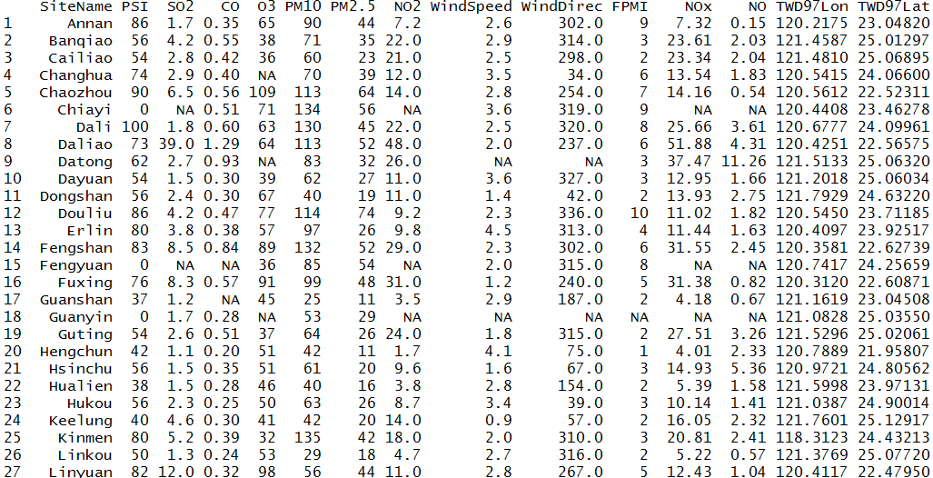
Exercise
Merge two datasets, AQX.csv and AQXsite.csv, by ‘SiteName’

Slide 77
Control Structures

Slide 78
Control Structures - if
if (cond) expr
if (cond) expr1 else expr2
> a=2
> if (a %% 2 == 1) print ("odd") else print ("even")
[1] "even"

Slide 79
Control Structures - for
for (var in seq) expr
var : variable
seq : vector
> sum=0
> for (i in 1:20){sum = sum + i}
> sum
[1] 210

Slide 80
Control Structures - for
Example : Multiplication table
> a=rep(c(0),times=81)
> dim(a)=c(9,9)
> for (i in 1:9) {
+ for(j in 1:9){
+ a[i,j]=i*j}}

Slide 81

Exercise
Pascal Triangle

Slide 82
Control Structures - for
> x = unique(iris[,5])
> y = 0
> for (i in x)
+ {
+ y[i] = mean(iris[iris[,5]==i,1])
+ }
> y
setosa versicolor virginica
0.000 5.006 5.936 6.588
> x = unique(iris[,5])
> y = 0
> for (i in 1:length(x))
+ {
+ y[i] = mean(iris[iris[,5]==x[i],1])
+ }
> names(y)=x
> y
setosa versicolor virginica
5.006 5.936 6.588

Slide 83

Exercise
Calculate the average of Sepal.Length, Sepal.Width, Petal.Length and Petal.Width of each species in IRIS dataset.

Slide 84

Exercise
Calculate the average concentration of NO2, PM10, PM2.5, O3 and SO2 of each station.
Data:
x=read.csv("AirPollution.csv",header=T)

Slide 85
Control Structures - repeat
repeat expr_repeat
break statement is the only way to come out of the repeat loop
> sum=0
> i=1
> repeat{
+ sum=sum+i
+ i=i+1
+ if(i>20)break
+ }
> sum
[1] 210

Slide 86
Control Structures - while
while (cond) expr
> sum=0
> i=1
> while(i<=20){
+ sum=sum+i
+ i=i+1
+ }
> sum
[1] 210

Slide 87
Control Structures – next & break
next
halts the processing of the current iteration and advances the looping index
Like continue in C++
break
breaks out of a loop
> for (i in 1:5) { if (i==3) next else print(i)}
[1] 1
[1] 2
[1] 4
[1] 5
> for (i in 1:5) { if (i==3) break else print(i)}
[1] 1
[1] 2

Slide 88
Function

Slide 89
Function
myfunction <- function(arg1, arg2, ... ){ statements return(object) }
> sum_test<-function(x,y){
+ z=x+y
+ return(z)
}
> sum_test(2,3)
[1] 5
> z
Error: object ‘z' not found

Slide 90
Function & apply
> multi<-function(x)
+ {
+ result=1
+ for (i in 1:length(x))
+ {
+ result = result * x[i]
+ }
+ return(result)
+ }
> apply(iris[,1:4],1,multi)

Slide 91
recursive
> fac<-function(x){
+ if(x==1) return(1)
+ return (x*fac(x-1))
+ }
> fac(7)
[1] 5040

Slide 92
recursive
fib<-function(x){
+ if(x==0) return(0)
+ if(x==1) return(1)
+ return (fib(x-1)+fib(x-2))
+ }
> fib(7)
[1] 13

Slide 93
File

Slide 94
File - read table / read csv
> x=read.table("load_file.csv", header=T, sep=",",
+ colClasses=c("numeric","character","Date"))
> x
WD ID Date
1 2 tinin 2016-02-23
2 3 bp 2016-02-24
3 4 lee 2016-02-25
> x[2,]
WD ID Date
2 3 bp 2016-02-24
> x[,2]
[1] "tinin" "bp" "lee"
> colnames(x)
[1] "WD" "ID" "Date"

Slide 95
File – CSV (from web)
> install.packages("RCurl")
> library(RCurl)
> url =URLencode("http://opendata.epa.gov.tw/ws/Data/AQX/?format=csv&ndctype=CSV")
> x = readLines(url,encoding="UTF-8")
> col = unlist(strsplit(x[1],split=","))
> data = array(0,c(length(x)-1,length(col)))
> for (i in 2:length(x))
+ {
+ k = i-1
+ tmp=unlist(strsplit(x[i] ,split = ","))
+ for (j in 1:length(tmp))
+ {
+ data[k,j]=tmp[j]
+ }
+}
> colnames(data)=col
> rownames(data)=data[,1]

Slide 96
File - scan (read file)
> x=scan("load_file_scan.csv", what=list(numeric(),
+ character(), character()),sep=",")
Read 3 records
> x
[[1]]
[1] 2 3 4
[[2]]
[1] "tinin" "bp" "lee"
[[3]]
[1] "2016/2/23" "2016/2/24" "2016/2/25"

Slide 97
File –XLSX
> install.packages("xlsx")
> library(xlsx)
> x=read.xlsx("PM25.xlsx",sheetName="PM25")

Slide 98
File - XML
> install.packages("XML")
> library(XML)
# From Web
> url = "http://opendata2.epa.gov.tw/AQX.xml"
> x = xmlParse(url, encoding = "utf8")
> xmlfiles = xmlRoot(x)
> y = xmlToDataFrame(xmlfiles)
# From File
> x = xmlParse("AQX.xml", encoding = "utf8")
> xmlfiles = xmlRoot(x)
> y = xmlToDataFrame(xmlfiles)

Slide 99
File - JSON
> install.packages("jsonlite")
> library(jsonlite)
# From Web
> url = "http://opendata.epa.gov.tw/ws/Data/AQX/?format=json&ndctype=JSON"
> x = fromJSON(url,flatten = TRUE)
# From File
> x = fromJSON("AQX.json",flatten = TRUE)

Slide 100

File - cat & write
> x=matrix(4:9,2,3)
> x
[,1] [,2] [,3]
[1,] 4 6 8
[2,] 5 7 9
> cat(1:3, sep="\t", file="out.txt")
> cat("\n",file="out.txt",append=T)
> write( x, ncolumns=3, file="out.txt",append=T)

Slide 101
File - write table
> a=data.frame(WD=c(2,3,4), ID=c("tinin","bp","lee"),
+ Date=as.Date(c("2016-02-23","2016-02-24","2016-02-25")),
+ PHONE=c("0910","0955","0933"))
> write.table(a, file="out.csv", row.names=F,
+ col.names=T, sep=",")

Slide 102
File - sink (write file)
> sink(file="out.txt") #open
> x=read.table("load_file.csv", header=T, sep=",",
+ colClasses=c("numeric","character","Date"))
> x
> x
> sink() #close

Slide 103
Convert file type
# xlsx to csv
> x=read.xlsx("AQX.xlsx",sheetName="AQX")
> write.table(x,file="out.csv",col.names = T,row.names = F,sep=",")
# xml to csv
> x = xmlParse("AQX.xml", encoding = "utf8")
> xmlfiles = xmlRoot(x)
> y = xmlToDataFrame(xmlfiles)
> write.table(y,file="out.csv",col.names = T,row.names = F,sep=",")
# json to csv
> x = fromJSON("AQX.json",flatten = TRUE)
> write.table(x,file="out.csv",col.names = T,row.names = F,sep=",")

Slide 104
Exercise
Convert a lot of xlsx files to csv
Hint :
filelist = list.files(path = "AQdata")
for (i in 1:length(filelist))

Slide 105
dplyr

Slide 106
dplyr
Like SQL command
Filter (like where), select, arrange(like order by), mutate (add column), group_by
Inner join, left join

Slide 107
dplyr
Filter data
> install.packages("dplyr")
> library("dplyr")
> titanic = data.frame(Titanic)
> titanic[titanic$Sex=="Male" & titanic$Age=="Adult", ]
# use filter
> filter(titanic, Sex == "Male" & Age== "Adult") #AND
> filter(titanic, Sex == "Male" | Age== "Adult") #OR
# find class in 1st and Crew
> filter(titanic, Class %in% c('1st', 'Crew'))

Slide 108
dplyr
select column
> titanic = data.frame(Titanic)
> titanic[, c("Sex","Age")]
# select column "Sex" and "Age"
> select(titanic, Sex, Age)
# select column from "Sex" to "Survived"
> select(titanic, Sex:Survived)
# column name contains "S"
> select(titanic, contains("S"))

Slide 109
dplyr
then function
%>% (like pipe | in linux)
> filter(select(titanic, Sex, Class, Age), Age == "Child")
# then function
> titanic %>% select(Sex, Class, Age) %>% filter(Age == "Child")

Slide 110
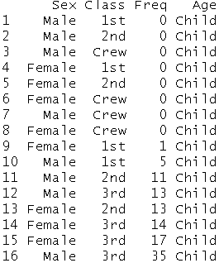
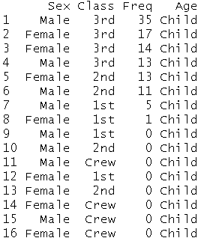
dplyr
Arrange
Like order by
> titanic %>%
+ select(Sex, Class, Freq, Age) %>%
+ filter(Age=="Child") %>%
+ arrange(Freq)
> titanic %>%
+ select(Sex, Class, Freq, Age) %>%
+ filter(Age=="Child") %>%
+ arrange(desc(Freq))

Slide 111
dplyr
mutate
Add column
> freqsum = titanic %>% select(Freq) %>% sum()
# add column portion
> titanic %>%
+ select(Sex,Age,Freq) %>%
+ mutate(portion= Freq/freqsum)
> new_titanic = titanic %>% mutate(portion= Freq/freqsum)

Slide 112
dplyr
Group_by
summarise
> titanic %>%
+ group_by(Sex) %>%
+ summarise(Sexsum = sum(Freq, na.rm=TRUE))
Sex Sexsum
1 Male 1731
2 Female 470
select Sex, sum(Freq) as Sexsum from titanic group by Sex

Slide 113
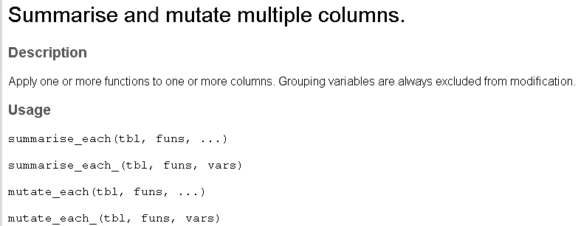

dplyr
summarise_each
> new_titanic %>%
+ group_by(Sex) %>%
+ summarise_each(funs(sum), Freq, portion)

Slide 114
dplyr
Count
Distinct
> titanic %>%
+ select(Sex) %>%
+ summarise_each(funs(n()))
Sex
1 32
> titanic %>%
+ select(Sex) %>%
+ summarise_each(funs(n_distinct(Sex)))
Sex
1 2

Slide 115
dplyr
summarise (sum) + group_by + arrange(order by)
> titanic %>%
+ group_by(Age, Sex) %>%
+ summarise(fs = sum(Freq)) %>%
+ arrange(desc(fs))
Age Sex frequency_sum
1 Child Male 64
2 Child Female 45
3 Adult Male 1667
4 Adult Female 425

Slide 116
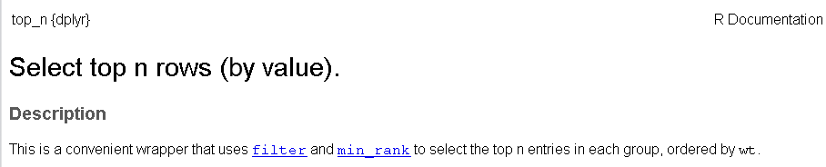
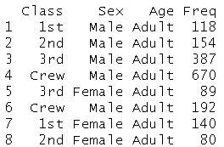
dplyr
top_n
# find top 2 of each class
> titanic %>%
+ group_by(Class) %>%
+ select(Sex,Age,Freq) %>%
+ top_n(2)

Slide 117
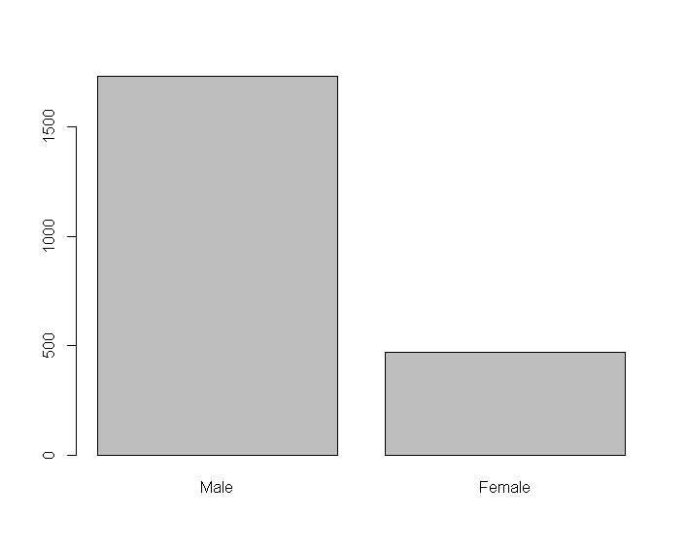
dplyr
plot + dplyr
> data = titanic %>%
+ group_by(Sex) %>%
+ summarise(Sexsum = sum(Freq, na.rm=TRUE))
Sex Sexsum
1 Male 1731
2 Female 470
> barplot(data$Sexsum, names.arg=data$Sex)

Slide 118
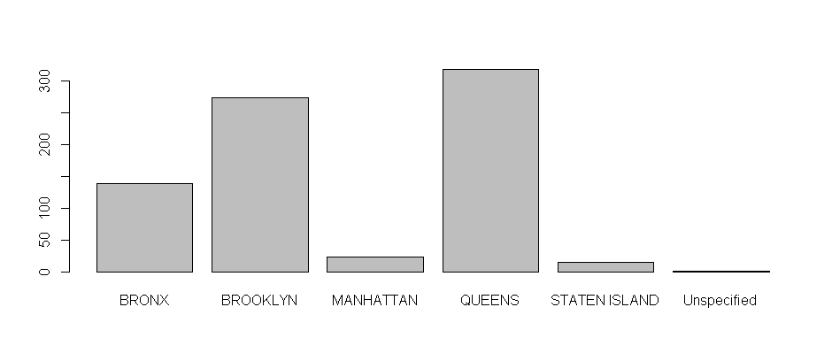
Exercise
Dataset:
311 dataset from NYC
https://data.cityofnewyork.us/Social-Services/311-Service-Requests-from-2010-to-Present/erm2-nwe9
311.csv
How many complaints of each type?
Column Name: Complaint.type
How many complaints about "Blocked Driveway" of each borough?
Column Name: Borough

Slide 119
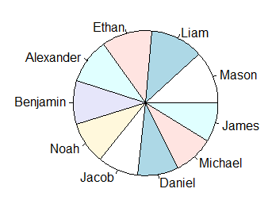
dplyr
Common name in English in 2012
> data = read.csv("name_english.csv",sep=",", header=F)
> colnames(data) = c("sex", "year", "name", "freq")
> top10_female = data %>%
+ filter(year == "2012" & sex == "F") %>%
+ group_by(name) %>%
+ summarise(count = sum(freq)) %>%
+ arrange(desc(count)) %>%
+ head(10)
> top10_male = data %>%
+ filter(year == "2012" & sex == "M") %>%
+ group_by(name) %>% summarise(count = sum(freq)) %>%
+ arrange(desc(count)) %>%
+ head(10)
> pie(top10_male$count, label = top10_male$name)

Slide 120
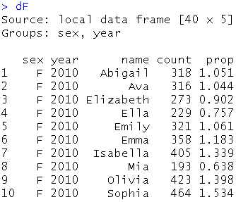
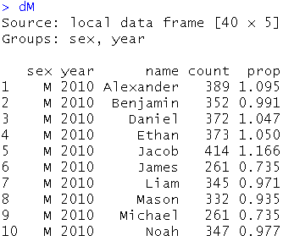
dplyr
Common name in English
> dF = data %>%
> group_by(sex, year, name) %>%
> summarise(count = sum(freq)) %>%
> group_by(sex, year) %>%
> mutate(prop = round(count * 100/sum(count), 3)) %>%
> filter(name %in% top10_female$name)
> dM = data %>%
> group_by(sex, year, name) %>%
> summarise(count = sum(freq)) %>%
> group_by(sex, year) %>%
> mutate(prop = round(count * 100/sum(count), 3)) %>%
> filter(name %in% top10_male$name)
> install.packages("ggplot2")
> library(ggplot2)
> ggplot(data = dF, aes(x=year, y=count, group=name)) + geom_path(aes(colour=name)) + + geom_point(aes(colour=name))
> ggplot(data = dM, aes(x=year, y=count, group=name)) + geom_path(aes(colour=name)) + + geom_point(aes(colour=name))

Slide 121
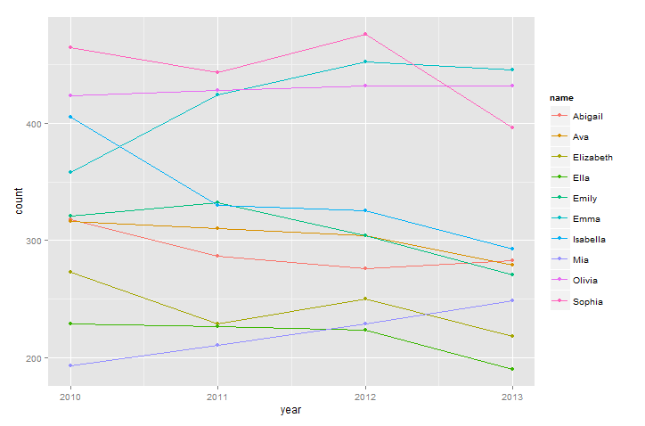
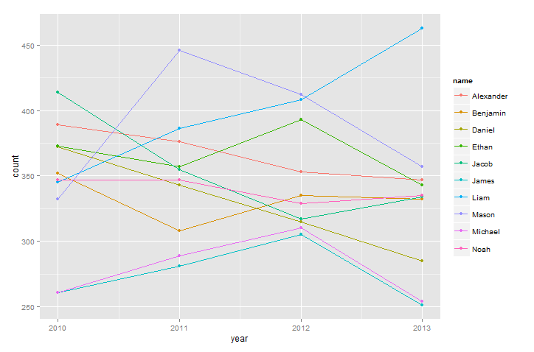
dplyr
Common name in English

Slide 122
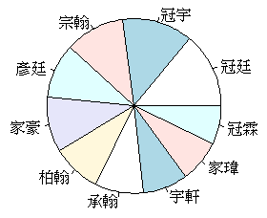
dplyr
菜市場名
> data = read.csv("name_chinese.csv",sep=",", header=F)
> colnames(data) = c("sex", "year", "name", "freq")
> top10_female = data %>%
+ filter(year == "2012" & sex == "F") %>%
+ group_by(name) %>%
+ summarise(count = sum(freq)) %>%
+ arrange(desc(count)) %>%
+ head(10)
> top10_male = data %>%
+ filter(year == "2012" & sex == "M") %>%
+ group_by(name) %>% summarise(count = sum(freq)) %>%
+ arrange(desc(count)) %>%
+ head(10)
> pie(top10_male$count, label = top10_male$name)

Slide 123
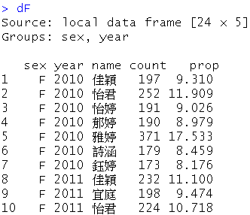
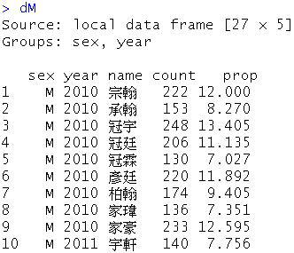
dplyr
菜市場名
> dF = data %>%
> group_by(sex, year, name) %>%
> summarise(count = sum(freq)) %>%
> group_by(sex, year) %>%
> mutate(prop = round(count * 100/sum(count), 3)) %>%
> filter(name %in% top10_female$name)
> dM = data %>%
> group_by(sex, year, name) %>%
> summarise(count = sum(freq)) %>%
> group_by(sex, year) %>%
> mutate(prop = round(count * 100/sum(count), 3)) %>%
> filter(name %in% top10_male$name)
> install.packages("ggplot2")
> library(ggplot2)
> ggplot(data = dF, aes(x=year, y=count, group=name)) + geom_path(aes(colour=name)) + + geom_point(aes(colour=name))
> ggplot(data = dM, aes(x=year, y=count, group=name)) + geom_path(aes(colour=name)) + + geom_point(aes(colour=name))

Slide 124
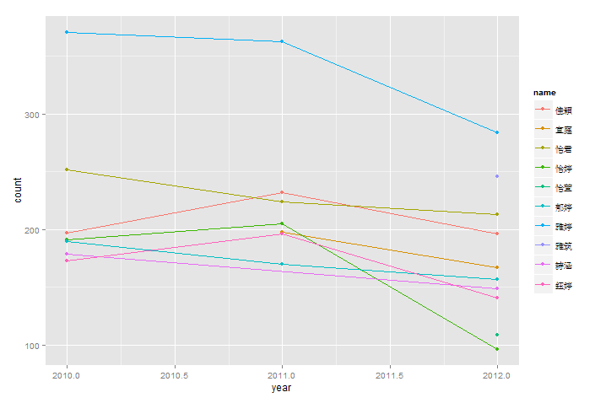
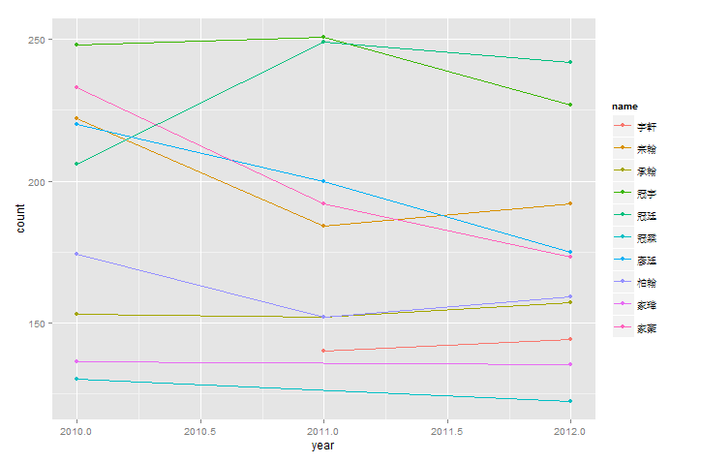
dplyr
菜市場名

Slide 125
Q & A

